Slide 1
Introductory General Chemistry
Chemistry 3A
Mitch Halloran

Slide 2
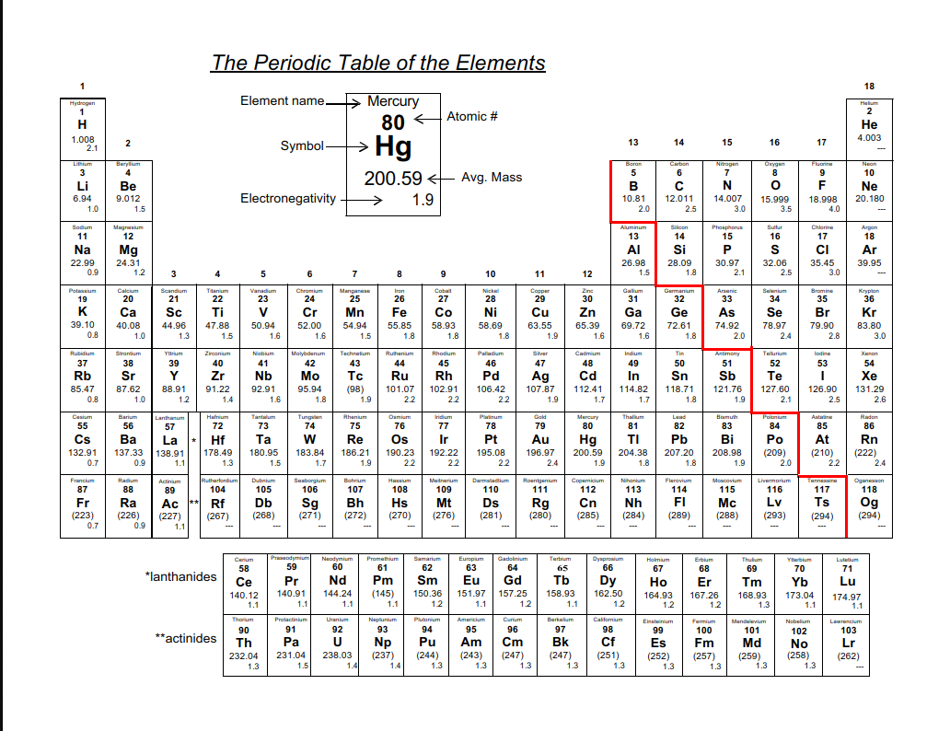

Slide 3
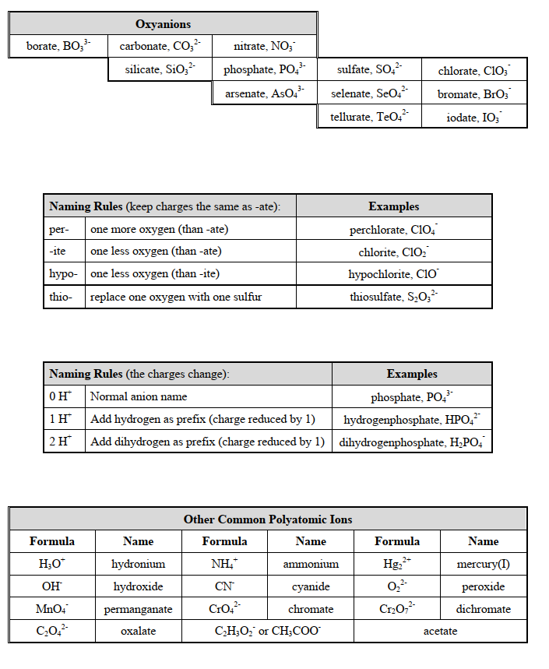

Slide 4
Polyatomic Ions
Measurements of mass and of length in one dimension and length in three dimensions to get volume are common in the laboratory
In this experiment you determine mass and volume and length measurements on a metal bar and on pure aluminum shot to get the property of density
Is the metal bar aluminum or another metal based on your calculations?

Slide 5
Polyatomic vs Molecular Ion
Extra stuff: no need to memorize
When atoms are bonded together, that looks like a molecule, right?
But chemists have a certain terminology here when it comes to polyatomic vs molecular ions
Methane (CH₄) is normally not an ionized molecule. But it can be if one uses high energy to knock an electron out. This is an unstable ion formation
In polyatomic ions, these are ionized as part of a stable state, and they remained ionized

Slide 6
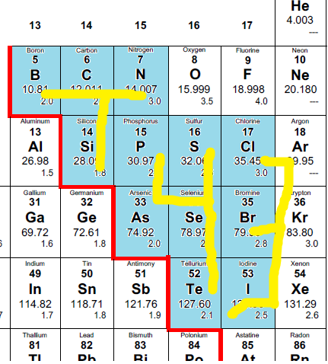
T43 Method
T: B, C, N, Si
4: P, S, As, Se, Te
3: Cl, Br, I
Oxygens:
4: PO₄, SO₄, AsO₄, SeO₄, TeO₄
3: ClO₃, BrO₃, IO₃
T: BO₃, CO₃, NO₃, SiO₃
Charged:
3-> (-1): ClO₃⁻, BrO₃⁻, IO₃⁻
4-> (-2): PO₄²⁻, SO₄²⁻, AsO₄²⁻, SeO₄²⁻, TeO₄²⁻
T: BO₃³⁻, CO₃²⁻, SiO₃²⁻, NO₃¹⁻
(start from N [1-], then C and Si [both 2-], then B [3-])

Slide 7
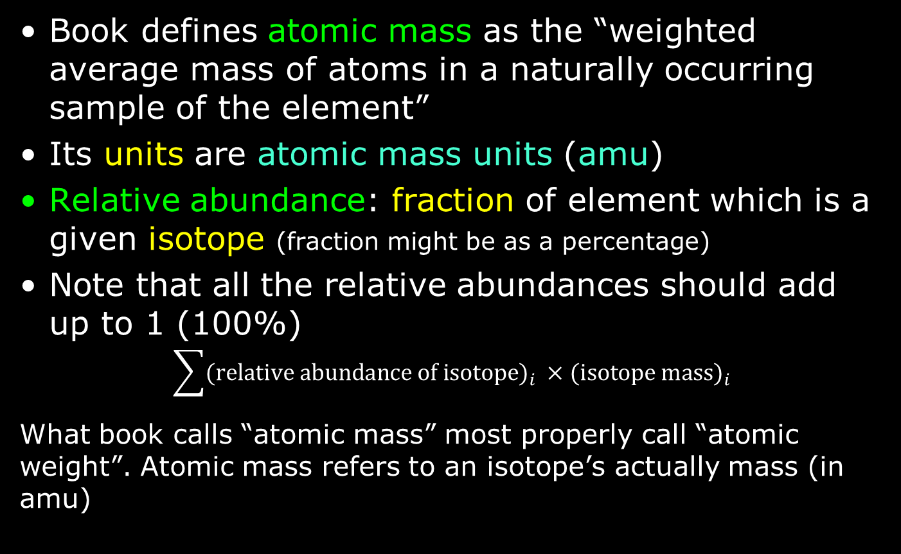
Table Atomic Mass: A Weighted Average
Book defines atomic mass as the “weighted average mass of atoms in a naturally occurring sample of the element”
Its units are atomic mass units (amu)
Relative abundance: fraction of element which is a given isotope (fraction might be as a percentage)
Note that all the relative abundances should add up to 1 (100%)
$$\sum{{\text{(}\text{relative} \text{abundance} \text{of} \text{isotope}\text{)}}_{i} ×{\text{(}\text{isotope} \text{mass}\text{)}}_{i}}$$
What book calls “atomic mass” most properly call “atomic weight”. Atomic mass refers to an isotope’s actually mass (in amu)

Slide 8
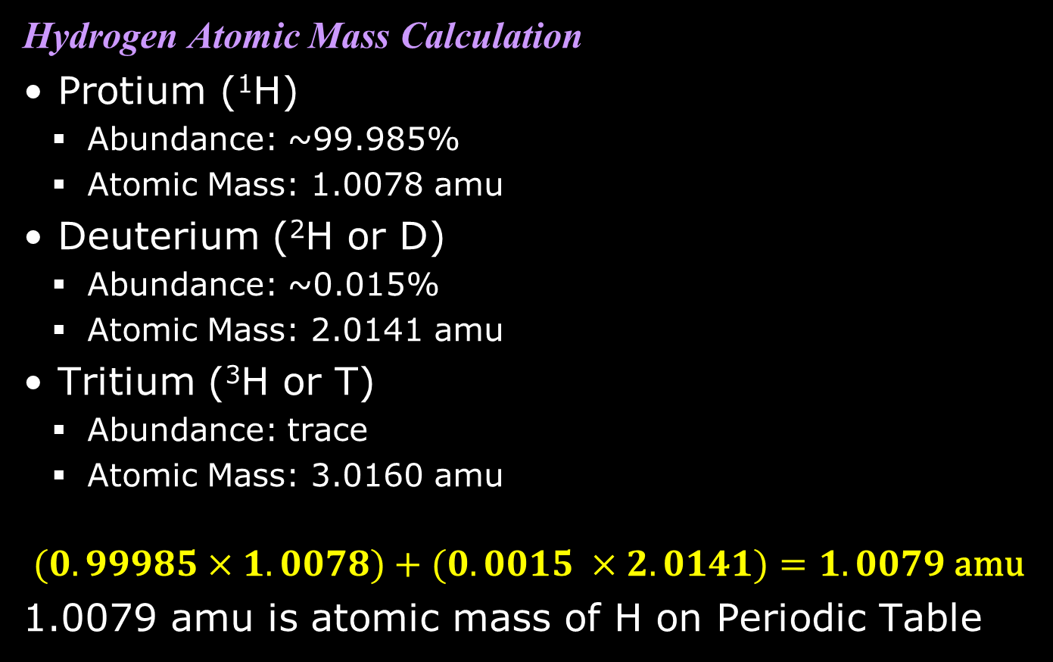
Atomic Mass Calculation
Hydrogen Atomic Mass Calculation
Protium (¹H)
  Abundance: ~99.985%
  Atomic Mass: 1.0078 amu
Deuterium (²H or D)
  Abundance: ~0.015%
  Atomic Mass: 2.0141 amu
Tritium (³H or T)
  Abundance: trace
  Atomic Mass: 3.0160 amu
$$(0.99985×1.0078)+(0.0015 ×2.0141)=1.0079 \text{amu}$$
1.0079 amu is atomic mass of H on Periodic Table

Slide 9
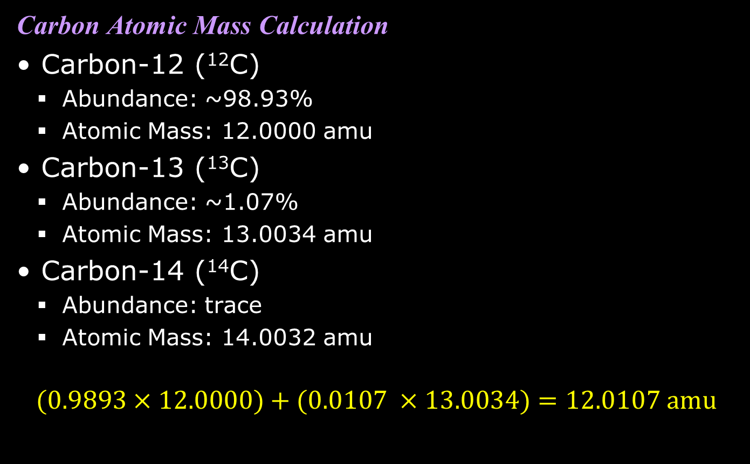
Atomic Mass Calculation
Carbon Atomic Mass Calculation
Carbon-12 (¹²C)
  Abundance: ~98.93%
  Atomic Mass: 12.0000 amu
Carbon-13 (¹³C)
  Abundance: ~1.07%
  Atomic Mass: 13.0034 amu
Carbon-14 (¹⁴C)
  Abundance: trace
  Atomic Mass: 14.0032 amu
$$(0.9893×12.0000)+(0.0107 ×13.0034)=12.0107 \text{amu}$$

Slide 10
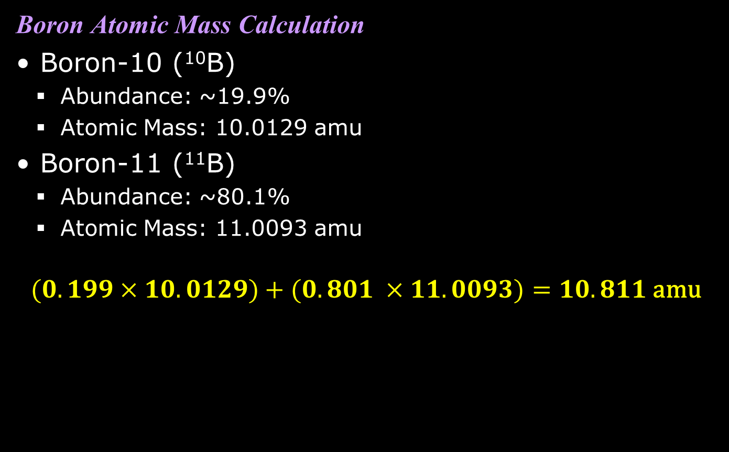
Atomic Mass Calculation
Boron Atomic Mass Calculation
Boron-10 (¹⁰B)
  Abundance: ~19.9%
  Atomic Mass: 10.0129 amu
Boron-11 (¹¹B)
  Abundance: ~80.1%
  Atomic Mass: 11.0093 amu
$$(0.199×10.0129)+(0.801 ×11.0093)=10.811 \text{amu}$$

Slide 11
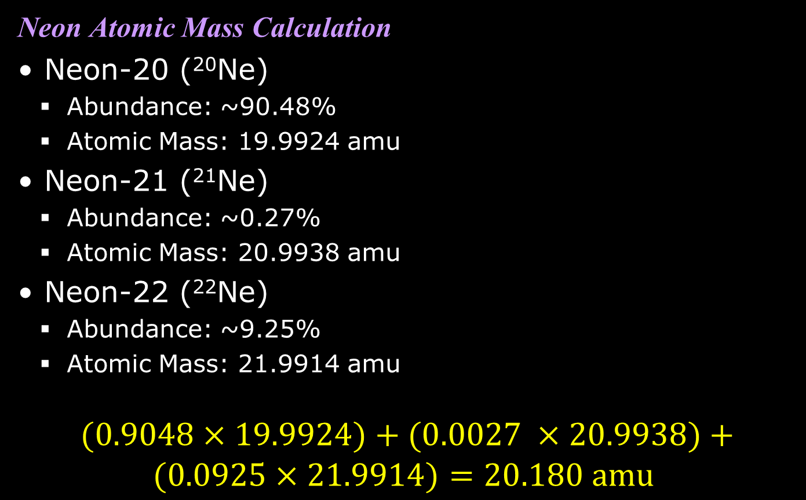
Atomic Mass Calculation
Neon Atomic Mass Calculation
Neon-20 (²⁰Ne)
  Abundance: ~90.48%
  Atomic Mass: 19.9924 amu
Neon-21 (²¹Ne)
  Abundance: ~0.27%
  Atomic Mass: 20.9938 amu
Neon-22 (²²Ne)
  Abundance: ~9.25%
  Atomic Mass: 21.9914 amu
$$(0.9048×19.9924)+(0.0027 ×20.9938)+ \\ (0.0925×21.9914)=20.180 \text{amu}$$

Slide 12
Table Atomic Mass: A Weighted Average
Book defines atomic mass as the “weighted average mass of atoms in a naturally occurring sample of the element”
Its units are atomic mass units (amu)
Relative abundance: fraction of element which is a given isotope (fraction might be as a percentage)
Note that all the relative abundances should add up to 1 (100%)
$$\sum{{\text{(}\text{relative} \text{abundance} \text{of} \text{isotope}\text{)}}_{i} ×{\text{(}\text{isotope} \text{mass}\text{)}}_{i}}$$
What book calls “atomic mass” most properly call “atomic weight”. Atomic mass refers to an isotope’s actually mass (in amu)

Slide 13
Atomic Mass Calculation
Hydrogen Atomic Mass Calculation
Protium (¹H)
  Abundance: ~99.985%
  Atomic Mass: 1.0078 amu
Deuterium (²H or D)
  Abundance: ~0.015%
  Atomic Mass: 2.0141 amu
Tritium (³H or T)
  Abundance: trace
  Atomic Mass: 3.0160 amu
$$(0.99985×1.0078)+(0.0015 ×2.0141)=1.0079 \text{amu}$$
1.0079 amu is atomic mass of H on Periodic Table

Slide 14
Atomic Mass Calculation
Carbon Atomic Mass Calculation
Carbon-12 (¹²C)
  Abundance: ~98.93%
  Atomic Mass: 12.0000 amu
Carbon-13 (¹³C)
  Abundance: ~1.07%
  Atomic Mass: 13.0034 amu
Carbon-14 (¹⁴C)
  Abundance: trace
  Atomic Mass: 14.0032 amu
$$(0.9893×12.0000)+(0.0107 ×13.0034)=12.0107 \text{amu}$$

Slide 15
Atomic Mass Calculation
Boron Atomic Mass Calculation
Boron-10 (¹⁰B)
  Abundance: ~19.9%
  Atomic Mass: 10.0129 amu
Boron-11 (¹¹B)
  Abundance: ~80.1%
  Atomic Mass: 11.0093 amu
$$(0.199×10.0129)+(0.801 ×11.0093)=10.811 \text{amu}$$

Slide 16
Atomic Mass Calculation
Neon Atomic Mass Calculation
Neon-20 (²⁰Ne)
  Abundance: ~90.48%
  Atomic Mass: 19.9924 amu
Neon-21 (²¹Ne)
  Abundance: ~0.27%
  Atomic Mass: 20.9938 amu
Neon-22 (²²Ne)
  Abundance: ~9.25%
  Atomic Mass: 21.9914 amu
$$(0.9048×19.9924)+(0.0027 ×20.9938)+ \\ (0.0925×21.9914)=20.180 \text{amu}$$

